Slide 1
ABOUT THIS RESOURCE
Introducing cast and crew members before the first rehearsal fosters trust, collaboration, and a sense of community. To support this, we send out a packet featuring personal bios and photos of everyone involved in the production. This document helps everyone know who they’ll be working with and who to contact for specific needs or questions. Use this PowerPoint template to collect and organize team bios and photos. Once completed, attach it to your welcome email to the entire cast and crew after casting is finalized and before the first rehearsal. This ensures everyone starts the process informed and connected.
**Delete this slide before distributing.

Slide 2
WHEN USING THIS RESOURCE
Keep everything….
  “Bite sized” – what are the “need to know now” items?
  Personable – include plenty of interests and talking points in your bio so you come off as approachable and so that performers can find something of interest to talk to you about
Consider sharing these on your social media accounts and website prior to registration/auditions too!
During a meet and greet, put this on a tv screen on rotation!
**Delete this slide before distributing.

Slide 3
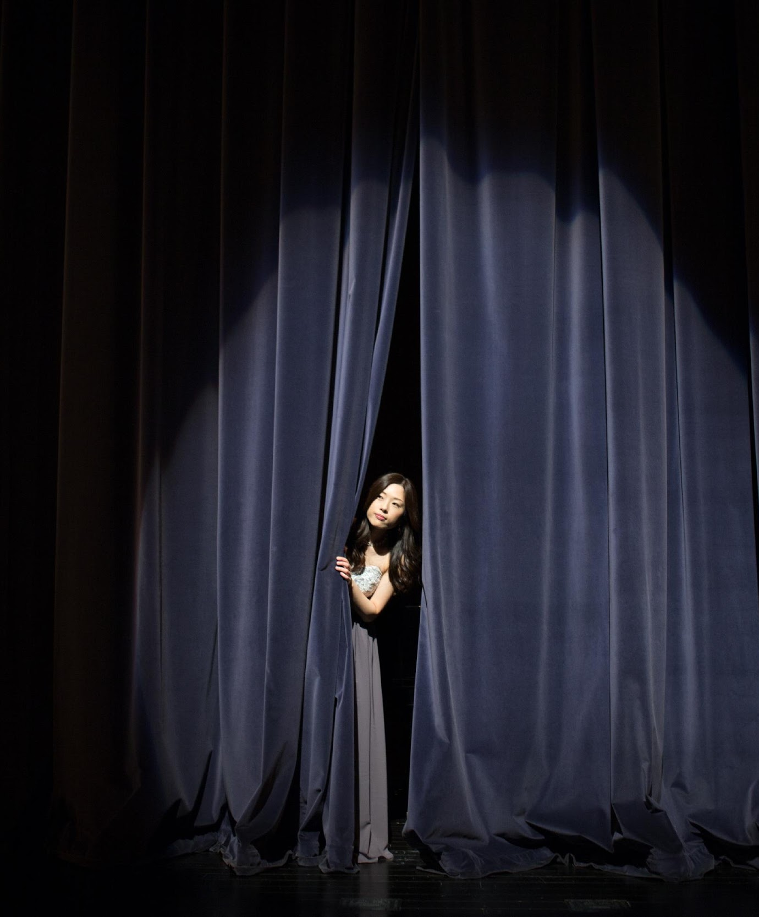
MEET YOUR PRODUCTION TEAM
Were excited to get started on our production of [insert show name]! Get to know the team you’ll be working with at [insert theater name].
Material produced for the Accessible Stages Collaborative, in partnership with Royal River Community Players, PO BOX 602, Yarmouth, Maine, WWW.RRCP.ME
© 2025 All rights reserved

Slide 4
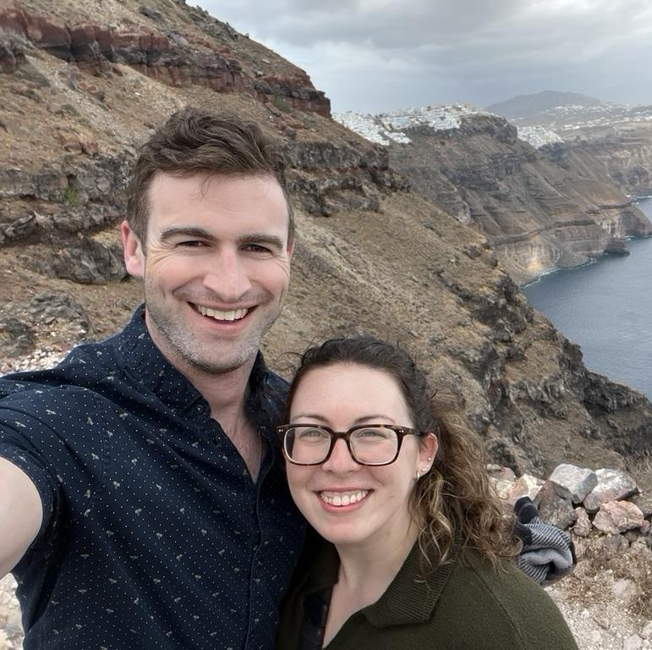
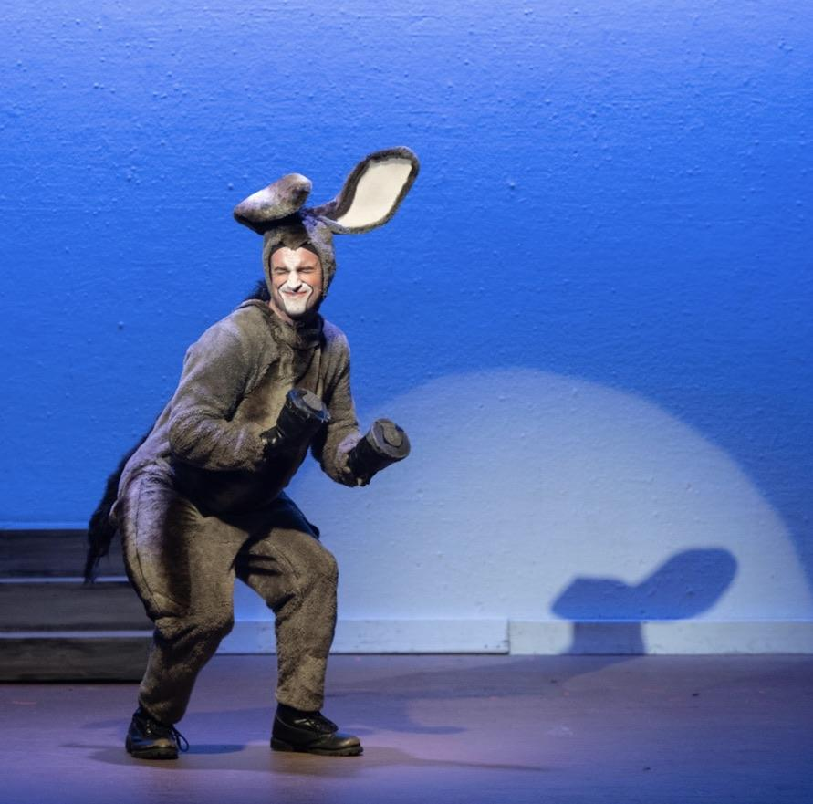
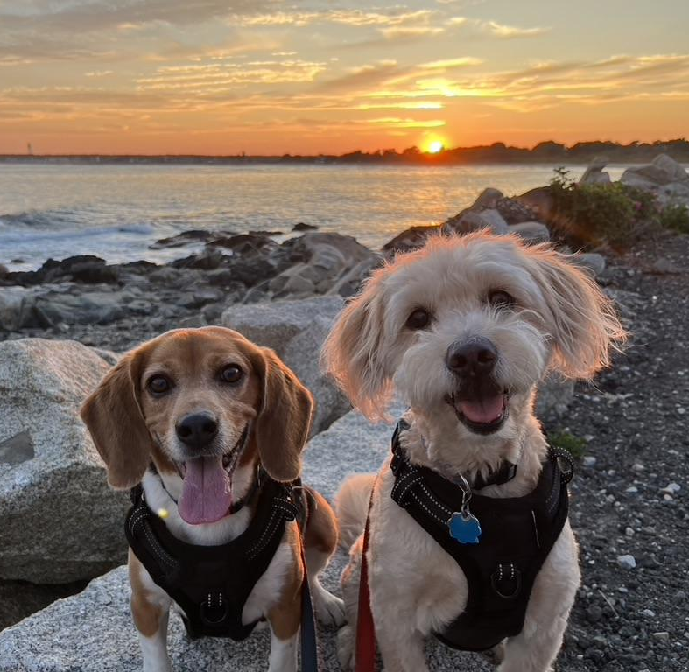
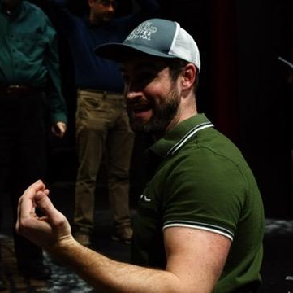
DIRECTOR:
DAVID SHEEHY (HE/HIM)
My name is David Sheehy but you can call me Dave. I love directing, music directing, and performing as much as possible. For work, I help design college courses and I teach college math. When I’m not working or performing, I love to kayak, travel, go to the gym, do puzzles or hang out with my dogs Harold (beagle) and Molly (goldendoodle). My wife Abby and I are expecting our first baby in October. I can’t wait to work with you!

Slide 5
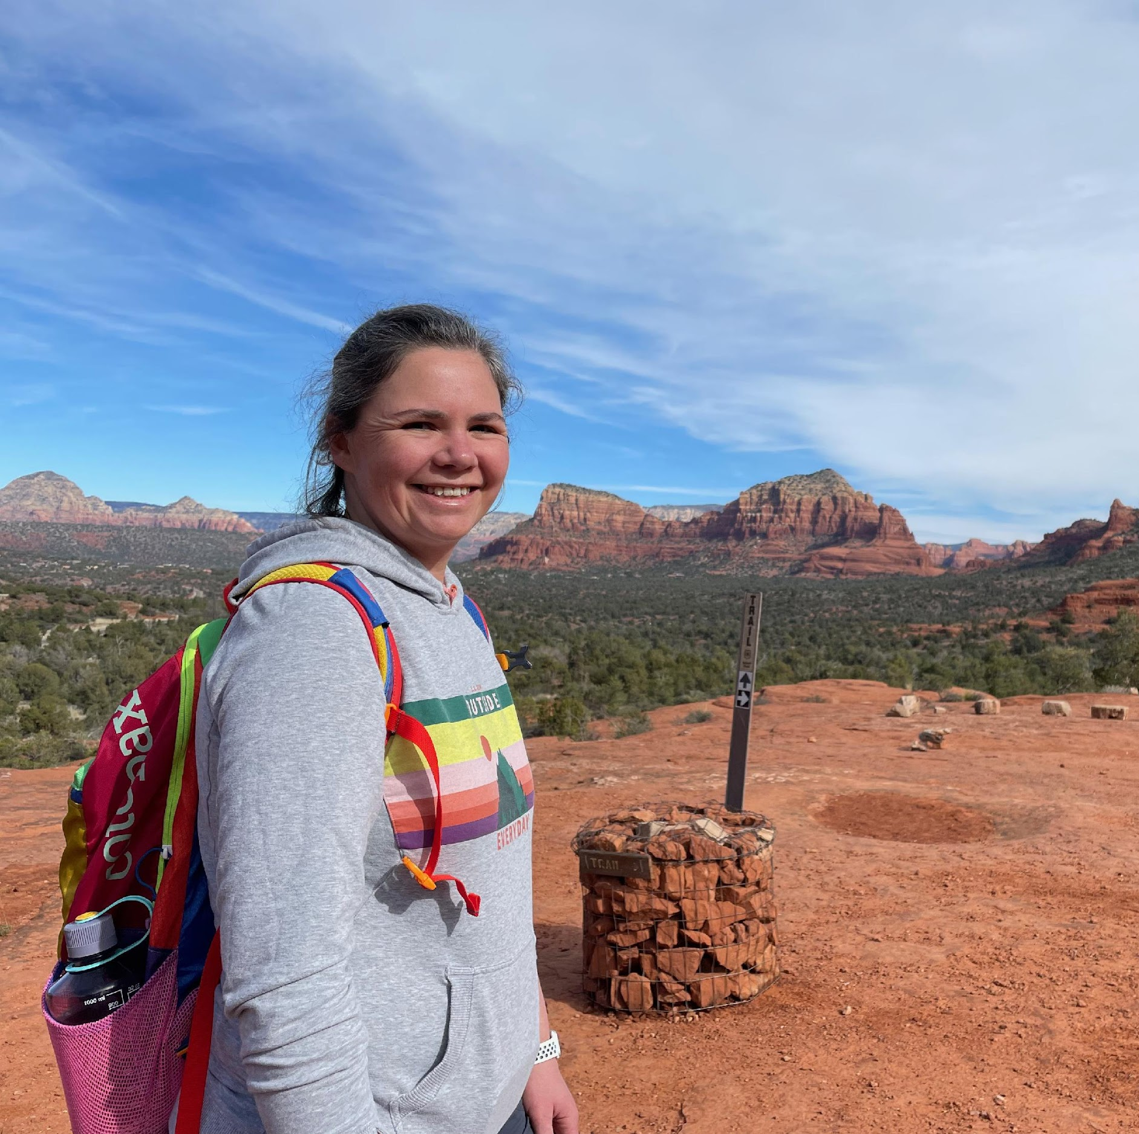
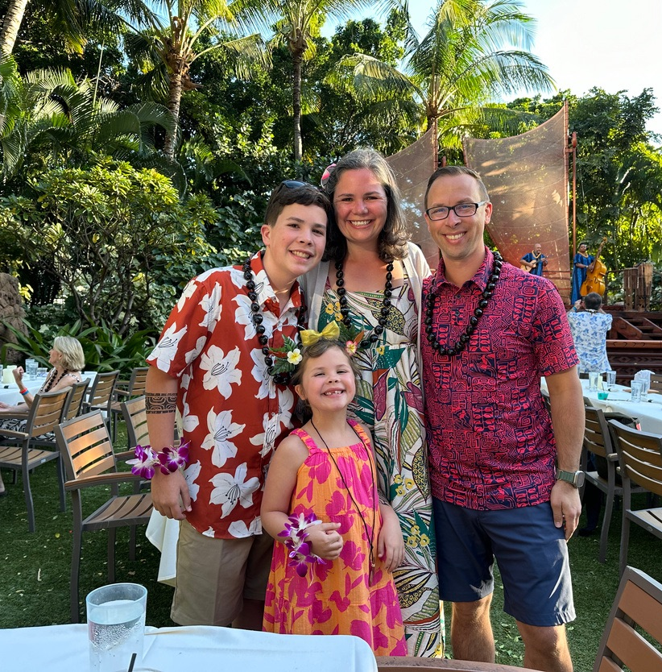
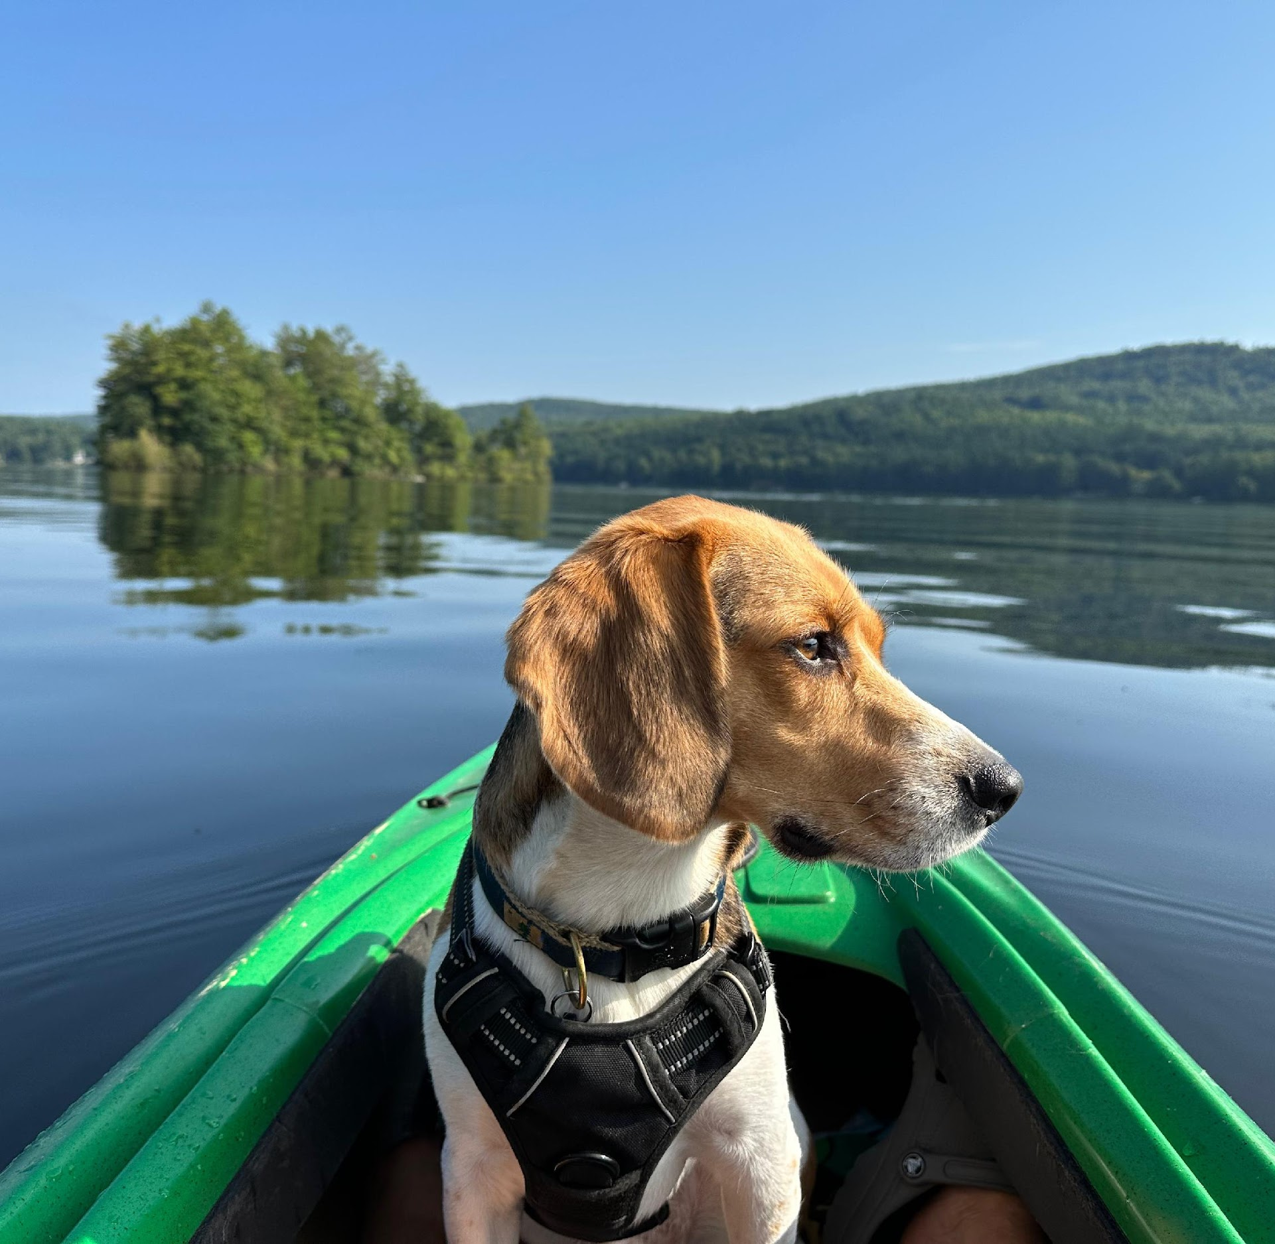
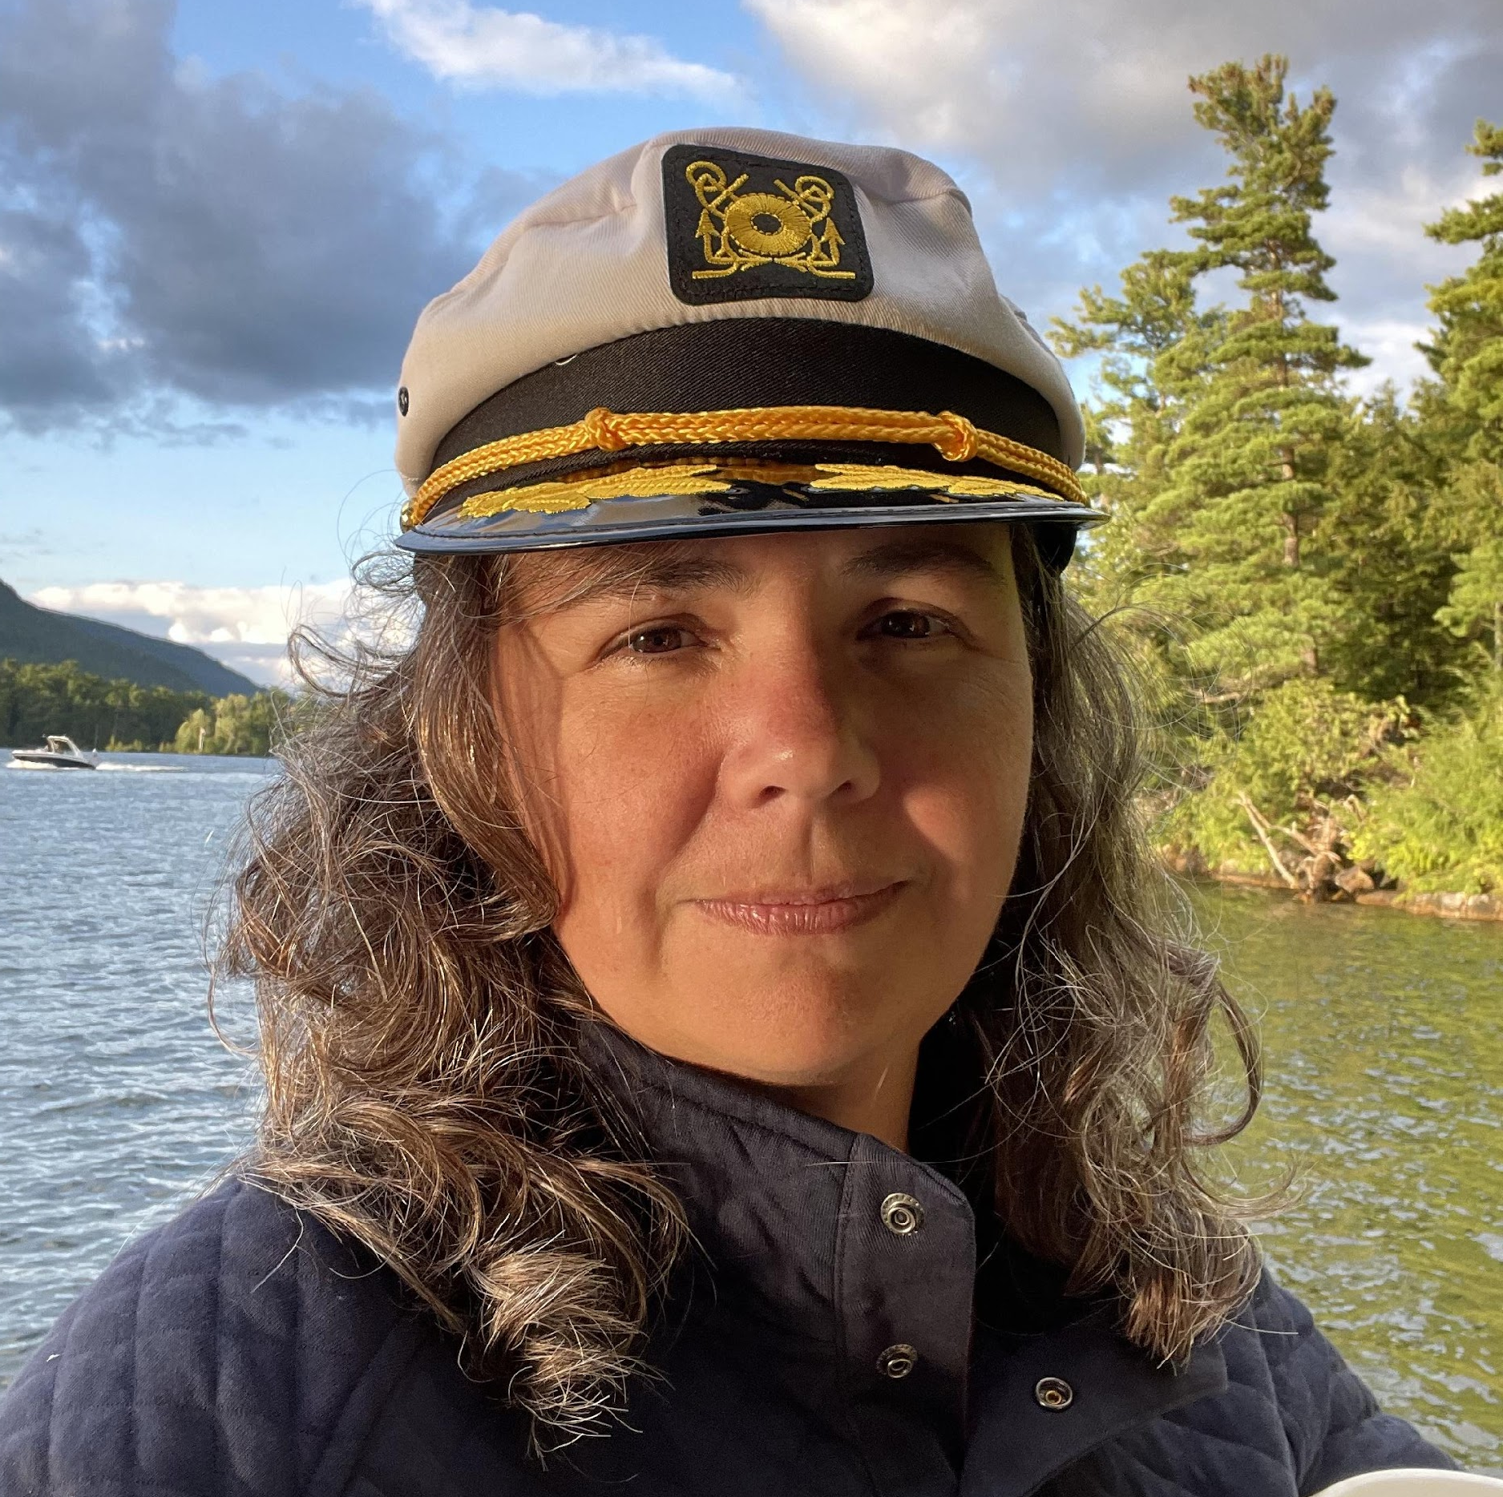
STAGE MANAGER:
JESS WALTON (SHE/HER)
My name is Jessica, but most people call me Jess. I love the challenge of being a stage manager and working with a diverse group of people as part of the process. When I’m not at the theater, I work as an Occupational Therapy Professor, teaching and working with students who are completing their clinical placements. In my free time, I enjoy spending time with my husband, two children, and my Beagle Gus. I love to travel and enjoy the outdoors, particularly through activities like hiking, fishing, camping, and kayaking. I'm excited to work with all of you and be part of this process!

Slide 6
IMPORTANT INFORMATION/FAQS
First rehearsal: Wednesday, April 12th, 2026 at 6:30pm at Royal River Community Players.
When will I get my script? At the first rehearsal?
When are rehearsals? Every Monday, Wednesday, and Thursday from 6:30-8:30pm
Do I have to be at every rehearsal? No- a detailed schedule will be provided on the first day and updated periodically throughout the rehearsal period.
Who do I contact if I cannot be at rehearsal? Contact your stage manager, Jess Walton, at 555-9789 for last minute conflicts.

Slide 7
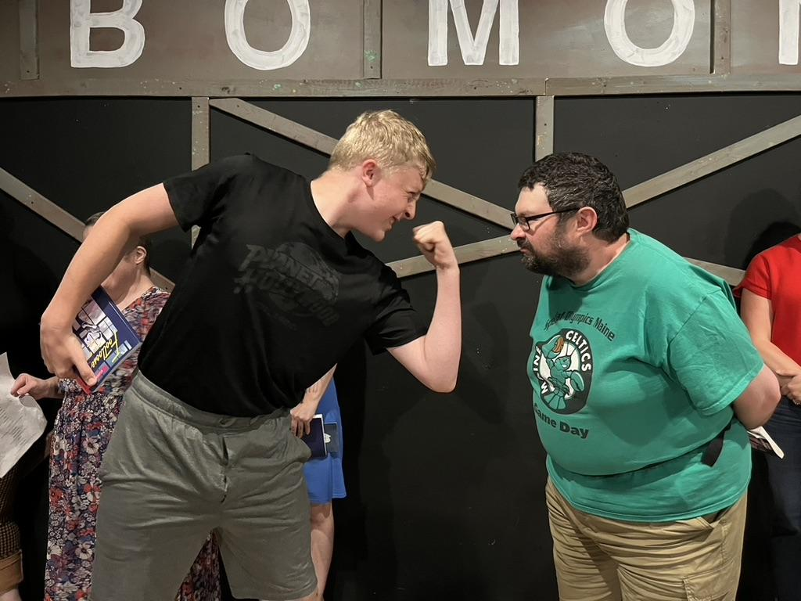
WHAT TO EXPECT ON YOUR FIRST DAY OF REHEARSAL
When you arrive on day one, we’ll do the following:
Pass out scripts, distribute name tags, and introduce the cast and crew.
Take care of “business:” Go over the rehearsal schedule, required paperwork, and everything you can expect for the next two and a half months.
Begin running music! Click on these links to listen to “When You’re an Addams” and “One Normal Night” to feel prepared.

