Slide 1
ABOUT THIS RESOURCE
Approach everything you do in a unified production from an educational perspective, especially blocking! Many new actors do not understand what blocking means. This resource will introduce them to blocking, notation, and basic stage directions so that everyone will have a baseline knowledge for getting started. Update this guide for your production and send it out before your first blocking rehearsal, then review the concepts and play "Simon Says: Stage Direction" at the start of the rehearsal.
**Delete this slide before distributing.

Slide 2
WHEN USING THIS RESOURCE
Keep everything….
  “Bite sized” – what are the “need to know now” items?
Consider sharing a picture straight from their script instead of our generic one so that it becomes even more familiar.
You can get as specific or as general about blocking. We kept it general here because, in our experience, you only have so much time!
**Delete this slide before distributing.

Slide 3
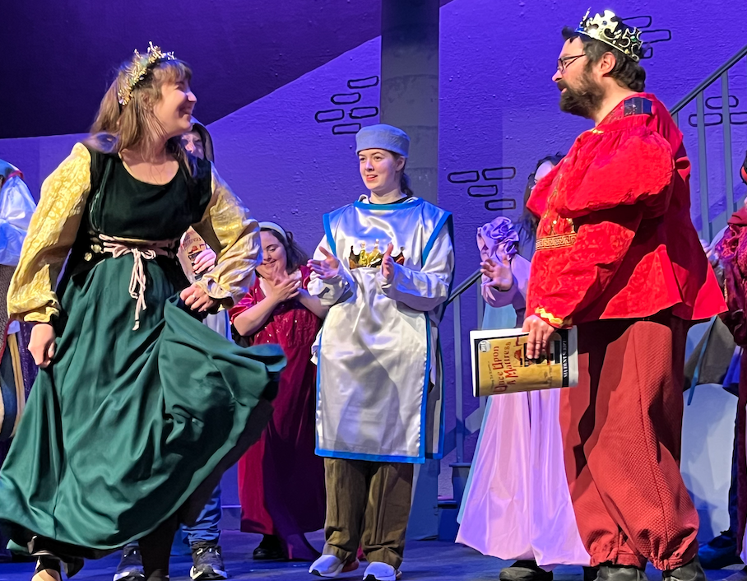
YOUR FIRST BLOCKING REHEARSAL
Material produced for the Accessible Stages Collaborative, in partnership with Royal River Community Players, PO BOX 602, Yarmouth, Maine, WWW.RRCP.ME
© 2025 All rights reserved

Slide 4
What is “Blocking?”
“Blocking” is a fancy word that describes WHERE you go onstage and WHEN to go there. During each blocking rehearsal we’ll look at a new scene and teach you where to go.

Slide 5
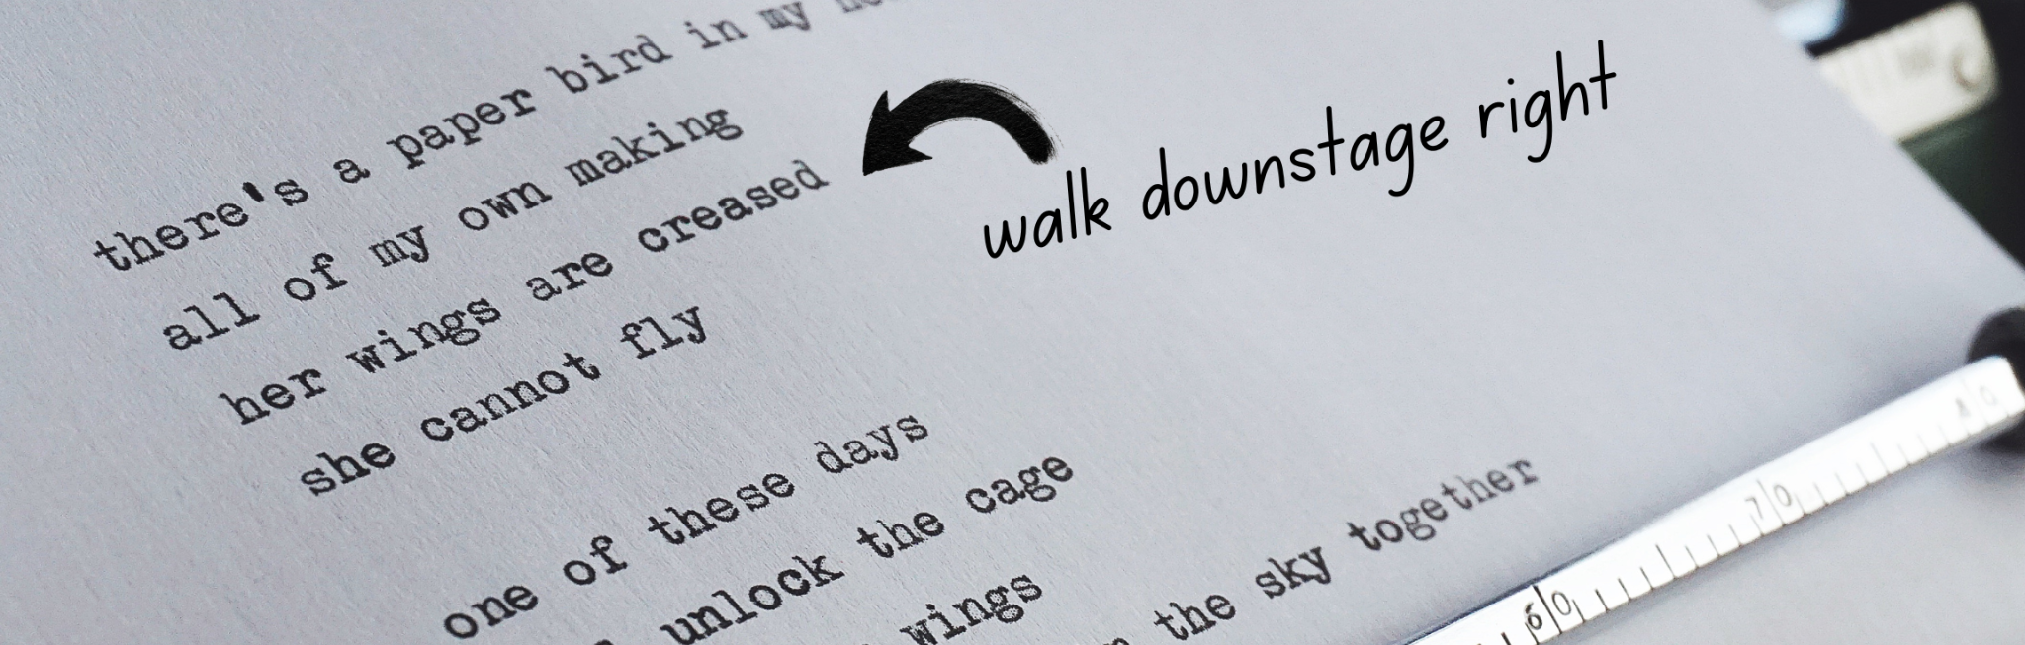
When we’re blocking, it’s a good idea to have a pencil with you and write down where you to move. For example, if the lines above were my dialogue and the director told me to “walk downstage right” when I say the line “her wings are creased,” I would make a note with an arrow like you see in the picture above.

Slide 6
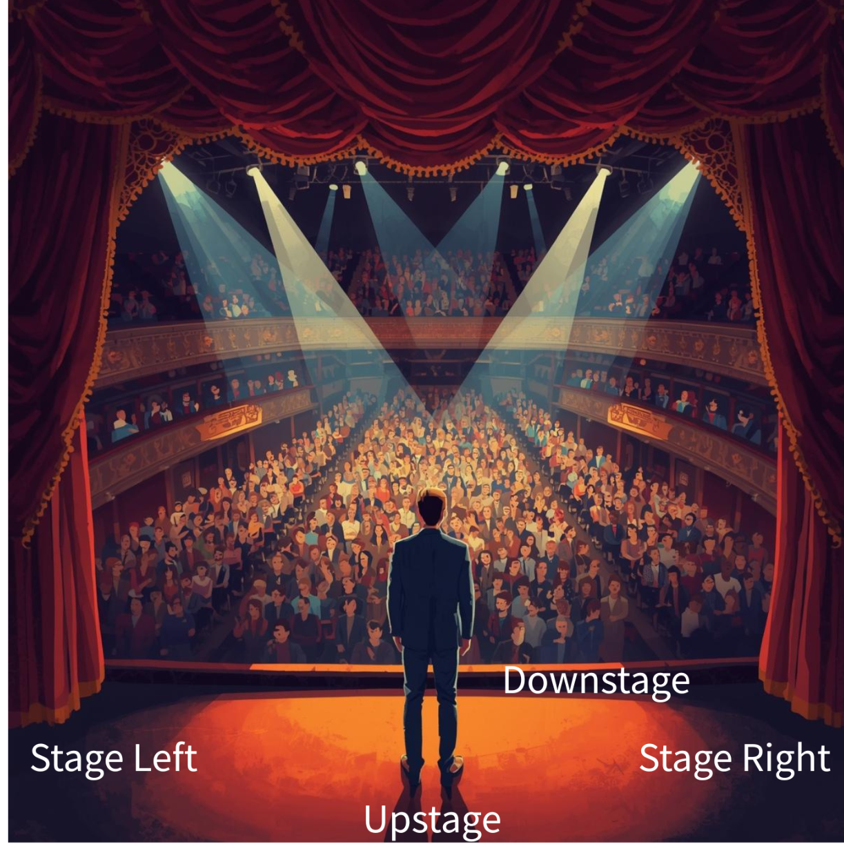
Stage Directions
But what does “stage left” or “downstage” mean? Here are explanations to accompany the picture on the right:
Stage left is the left side of the stage when you are looking out at the audience
Stage right is the right side of the stage when you are looking out at the audience
Upstage is the front of the stage, closest to the audience
Downstage is the back of the stage, furthest away from the audience.
These are labeled on our stage, and we’ll play a game on the first day of blocking to see what we remember!!

Slide 7
Bonus Idea - Simon Says: Stage Direction Edition!
It’s the classic game “Simon Says,” but use stage directions. Try calling commands such as Simon Says...
Walk stage left.
Hop upstage.
Face center stage. Now lift your upstage hand.
Start with posters labeling each part of the stage, and try covering them up the further you get into the rehearsal process.
*Delete this slide before presenting, but use it as a warmup!

Slide 8
What else should I know about blocking rehearsal?
We very likely won’t go from beginning to end - instead, we’ll bounce around from scene to scene throughout the show. Pay attention to what scene/page number we’re doing - I’ll be sure to say it before we start! If we’re not working in order, there’s probably a good reason for it. If I forget to tell you, or you’re interested to know, just ask!
Blocking rehearsals can involve a lot of sitting when you’re not in a scene we’re working on, and a lot of stopping and starting. There are a lot of you and you’re not always performing in the same parts! Sometimes I’ll need to focus on a single person’s or small group’s scene that doesn’t include you. It’s important to be patient, and don’t be afraid to ask for a break if you need one.
By the end of the rehearsal, you should be more comfortable with the scenes we learned, but they probably won’t be perfect! I recommend you practice them at home. Find a friend or family member to practice your lines with, and even act out the scene. If you have questions while you’re practicing, write them down or send me an email.

Slide 9
What is the best way to prepare for a blocking rehearsal?
I will let you know in advance what new scenes we’ll be working on before each blocking rehearsal. To feel prepared, here are some things you can do ahead of time:
Read the scene ahead of time so you know what’s happening in the scene.
Read through your lines in your script out loud. Practice them with a friend!
Bring a pencil! You’ll need to write things down, like where you’re moving on stage and who you’re standing with.

