Slide 1
ABOUT THIS RESOURCE
Technical elements can be some of the toughest elements of a production to integrate smoothly into any production, and it is especially important in a unified production that details of these transitions be communicated thoroughly in advance. This slideshow can be used all at once or in sections as new elements are introduced, such as a new theater space, lighting, props, costumes, or as a set. We encourage you to share this tool with your production team during pre-production and have them fill in the information for their discipline.
**Delete this slide before distributing.

Slide 2
WHEN USING THIS RESOURCE
Keep everything….
  “Bite sized” – what are the “need to know now” items?
  Visual - is there a picture to accompany information?
Use only the slides and information that you need and delete the rest. Even consider sending this out in multiple slideshows, that way you don’t get bogged down waiting for one person to send their information and risk sending some information late.
**Delete this slide before distributing.

Slide 3
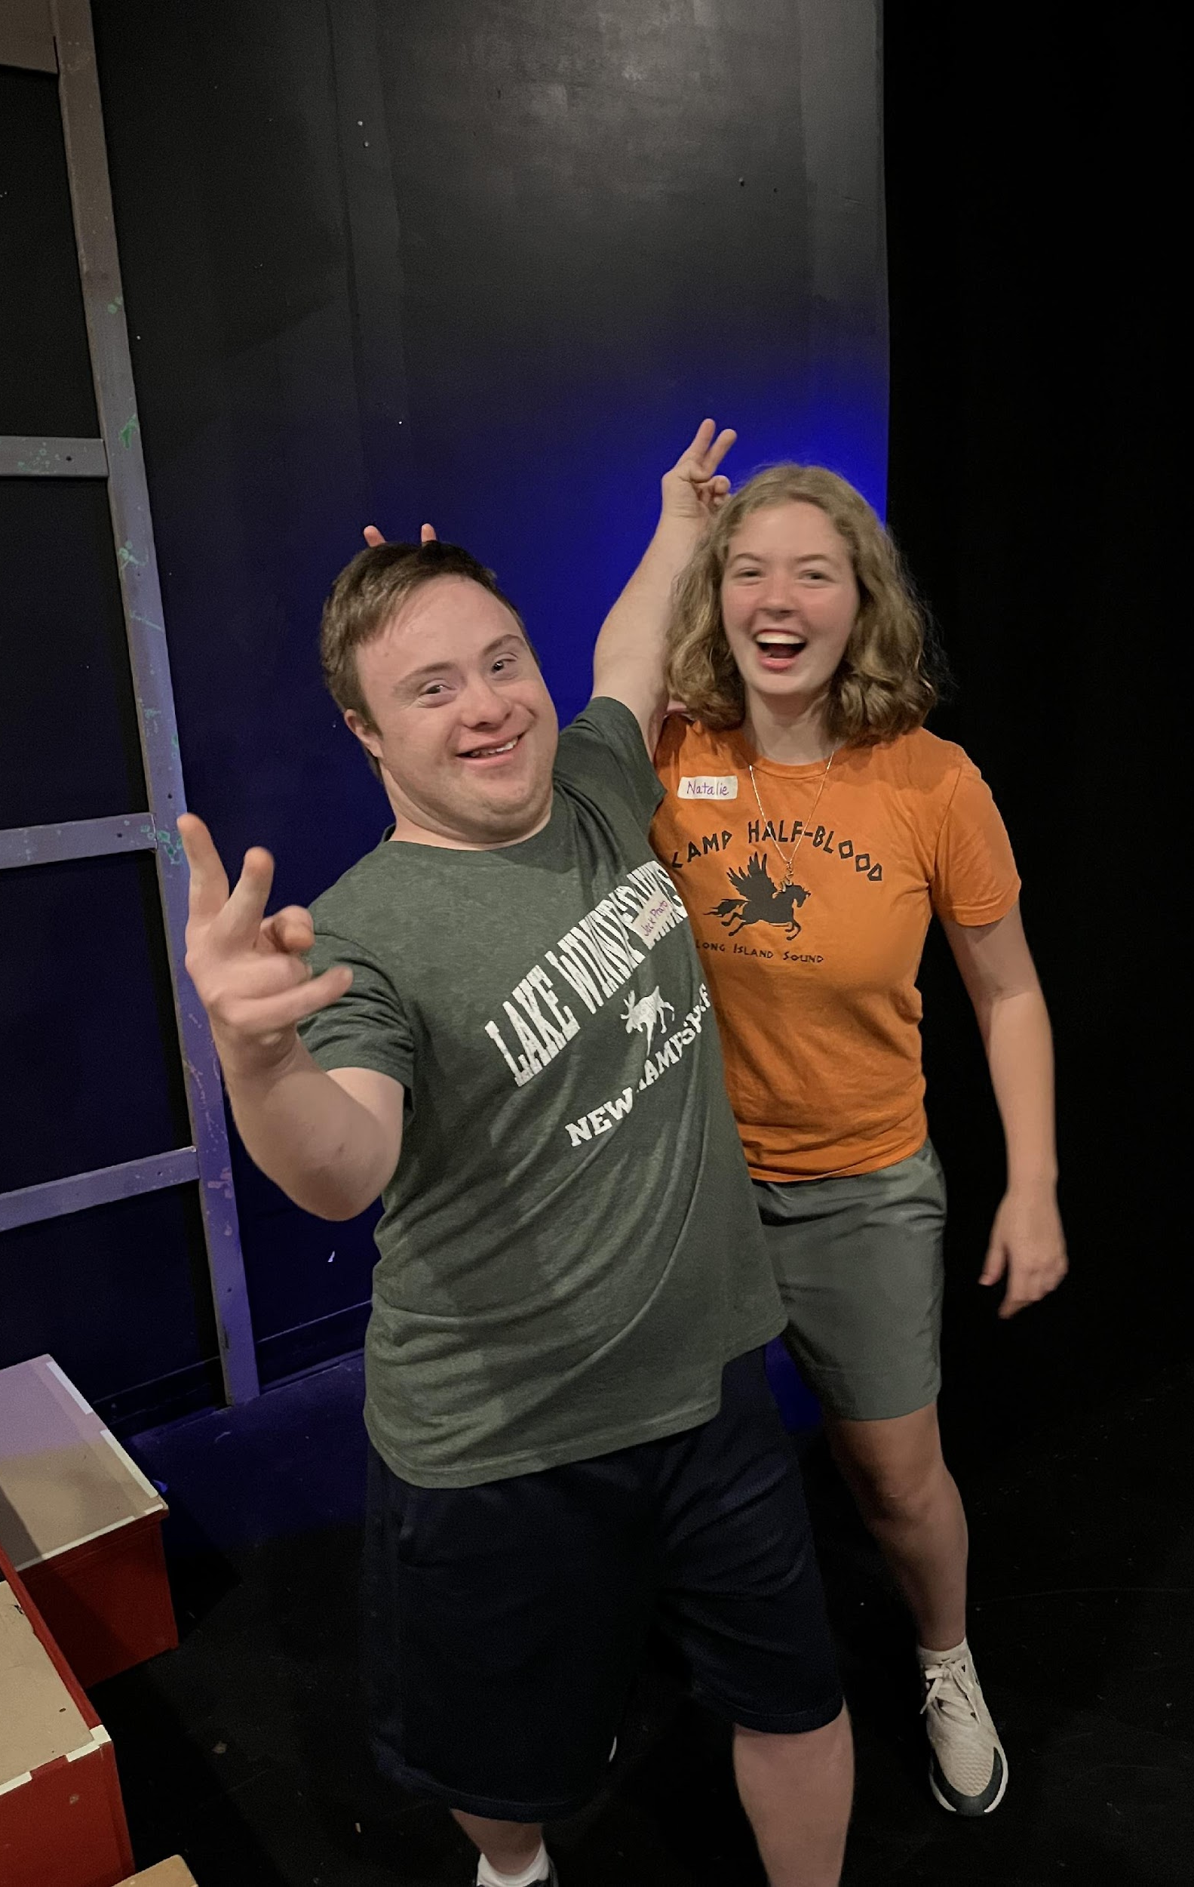
PREPARING FOR TECHNICAL ELEMENTS
Material produced for the Accessible Stages Collaborative, in partnership with Royal River Community Players, PO BOX 602, Yarmouth, Maine, WWW.RRCP.ME
© 2025 All rights reserved

Slide 4
When you arrive to the theater for tech rehearsals:
  Please go straight to your dressing room and put your costume on. Someone will be in each dressing room to help you if you need it.
  Once your costume is on, go get a microphone if you have been assigned one. The following performers need microphones: Larry, Matthew, Nida, Ophelia, and Penny.
  Then, find a seat in the audience. We’ll know we’re ready to begin when everyone is sitting in the house. While you’re waiting is a great time to practice your lines and lyrics with a friend!
  **Include whatever instructions are necessary for performers to get a strong start and a routine each day.**

Slide 5
Introducing You To the Theater
If you need to move into a new theater in the final week(s) of the run, or if you’ll be using new parts of the building that you haven’t used yet, this is a great place to upload a video tour. This is a great supplement to an in-person tour so performers know what to expect before they arrive.

Slide 6
Introducing You To the Set
When you get onstage you’ll see some changes! It’s not a clear floor anymore! Above is a picture of the set.
**Include a video tour above of the set. Explain any safety rules and re-explain them when you get to the theater to reinforce them. Use specific scenes and onstage events to help performers understand what everything is used for.**

Slide 7
Lighting
On Thursday we’ll begin using lighting during our rehearsals. Here are some things to keep in mind:
  If you ever feel unsafe for any reason, you can yell “hold” and everything will stop until we can make everything safe for you.
  The stage will get pretty dark at times. We will all stand onstage together and practice this. If it’s too dark for you to see where you’re going, please tell your stage manager (Jess) and we’ll adjust the level of light for you.
  We’ll also practice “finding your light” with a game! It’s always important to stand in the light and not in the dark when you’re in the middle of a scene. If you need more help understanding how this feels, just ask!

Slide 8
Bonus Idea - “Find Your Light” Game
Have performers spread themselves out onstage and put the stage in a blackout or dim lighting and tell them that as soon as the lights are on they need to “find their light.” Then, turn on the lights on specific sections of the stage and watch as they run around trying to stand in the light. This is a great game for a first tech rehearsal with everyone or before smaller blocking rehearsals with fewer performers. The stakes are low and the lessons are huge!
*Delete this slide before presenting, but use it as a warmup!

Slide 9
Props
On Monday we’ll begin using all of the props we have. Here’s what to expect and general expectations:
  Please only touch props that are yours. If you’re not sure if it’s your prop or not, ask! When you’re done with your props, please return them where you found them.
  If you’re supposed to have a prop in a scene but you don’t see it, please know that they’re on the way. If you still don’t have that prop by Friday, let someone know.
  Go backstage sometime before we start rehearsal Monday to see where your props are (we’ll remind you on Monday). The next two slides will show you where your props are.

Slide 10
Stage Left Props
Include a picture of the setup of props on Stage Left and list what is there and who each item belongs to. Describe the organization system being used too and help performers to see the labels. This may take multiple slides.

Slide 11
Stage Right Props
Include a picture of the setup of props on Stage Right and list what is there and who each item belongs to. Describe the organization system being used too and help performers to see the labels. This may take multiple slides.

Slide 12
Costumes
On Wednesday we’ll begin wearing costumes during our rehearsals. Here are some things to keep in mind:
  The men’s dressing room is located ***. The women’s dressing room is located ***. If you prefer a private place to change, you can do so ***.
  Please only wear costume pieces that are yours. If you’re not sure if it’s your costume or not, ask! When you’re done with your costumes, please put them back on hangers and return them to your designated space. Be sure the hanger has your name on it and you’re not using someone else’s hanger!
  The next slide(s) will show you where costumes are located and how they’re organized.
  Don’t forget to bring your required base layer on Wednesday, which includes a pair of shorts, a tank top, and comfortable shoes for all performers. If you need help getting something you don’t have, please speak with the costumer. Remember, once you bring everything to the theater it needs to stay at the theater.
***Use as many slides as you need to show performers where costumes are located and how they’re organized. The following slides will have sample text with information we recommend you include.***

Slide 13
Women’s Dressing Room
Above is a picture of the women’s dressing room. See how clean it is in this picture? Please be sure it is just as neat and tidy when you leave at the end of each rehearsal and performance. Every hanger is labeled with your name.

Slide 14
Women’s Dressing Room (continued)
Here is where Abigail’s, Bridgette’s, Calista’s, Danielle’s, and Edith’s costumes are. You can see their names labeled on the hangers.
***I would include as many slides as are needed until every performer sees their name.***

Slide 15
Men’s Dressing Room
Above is a picture of the men’s dressing room. See how clean it is in this picture? Please be sure it is just as neat and tidy when you leave at the end of each rehearsal and performance. Every hanger is labeled with your name.

Slide 16
Men’s Dressing Room (continued)
Here is where Aaron’s, Brad’s, Carter’s, Dean’s, and Edward’s costumes are. You can see their names labeled on the hangers.
***I would include as many slides as are needed until every performer sees their name.***

Slide 17
New Faces
**Use this page over and over to introduce new faces who will be present at rehearsals. Use the program to help you remember people, including backstage hands who are showing up at the 11th hour, a board operator performers have never met, and any volunteers. As soon as someone volunteers to help, ask them for a picture and brief bio.**

Slide 18
Final Thoughts
We’re getting closer and closer to the performance and we couldn’t be more excited! Please send us any questions you have if you’re confused or if you need help!

