Slide 1
WHEN USING THIS RESOURCE
Approach everything you do in a unified production from an educational perspective, especially in music! Not every performer has participated in a music rehearsal before. This resource includes introductory information that we have found helpful to share with actors so they know what to expect and how to prepare for their first music rehearsal. Feel free to update this guide for your production and send it out before your first music rehearsal. Update this guide for your production and send it out before your first music rehearsal, then review the concepts at the start of the rehearsal.
**Delete this slide before distributing.

Slide 2
WHEN USING THIS RESOURCE
Keep everything….
  “Bite sized” – what are the “need to know now” items?
Consider sharing segments of music straight from their script so that it becomes even more familiar.
You can get as specific or as general about music notation as you’d like. We kept it general here because, in our experience, you only have so much time!
**Delete this slide before distributing.

Slide 3
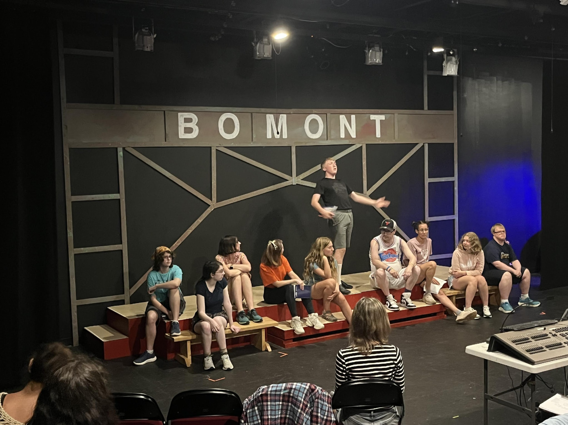
YOUR FIRST MUSIC REHEARSAL
Material produced for the Accessible Stages Collaborative, in partnership with Royal River Community Players, PO BOX 602, Yarmouth, Maine, WWW.RRCP.ME
© 2025 All rights reserved

Slide 4
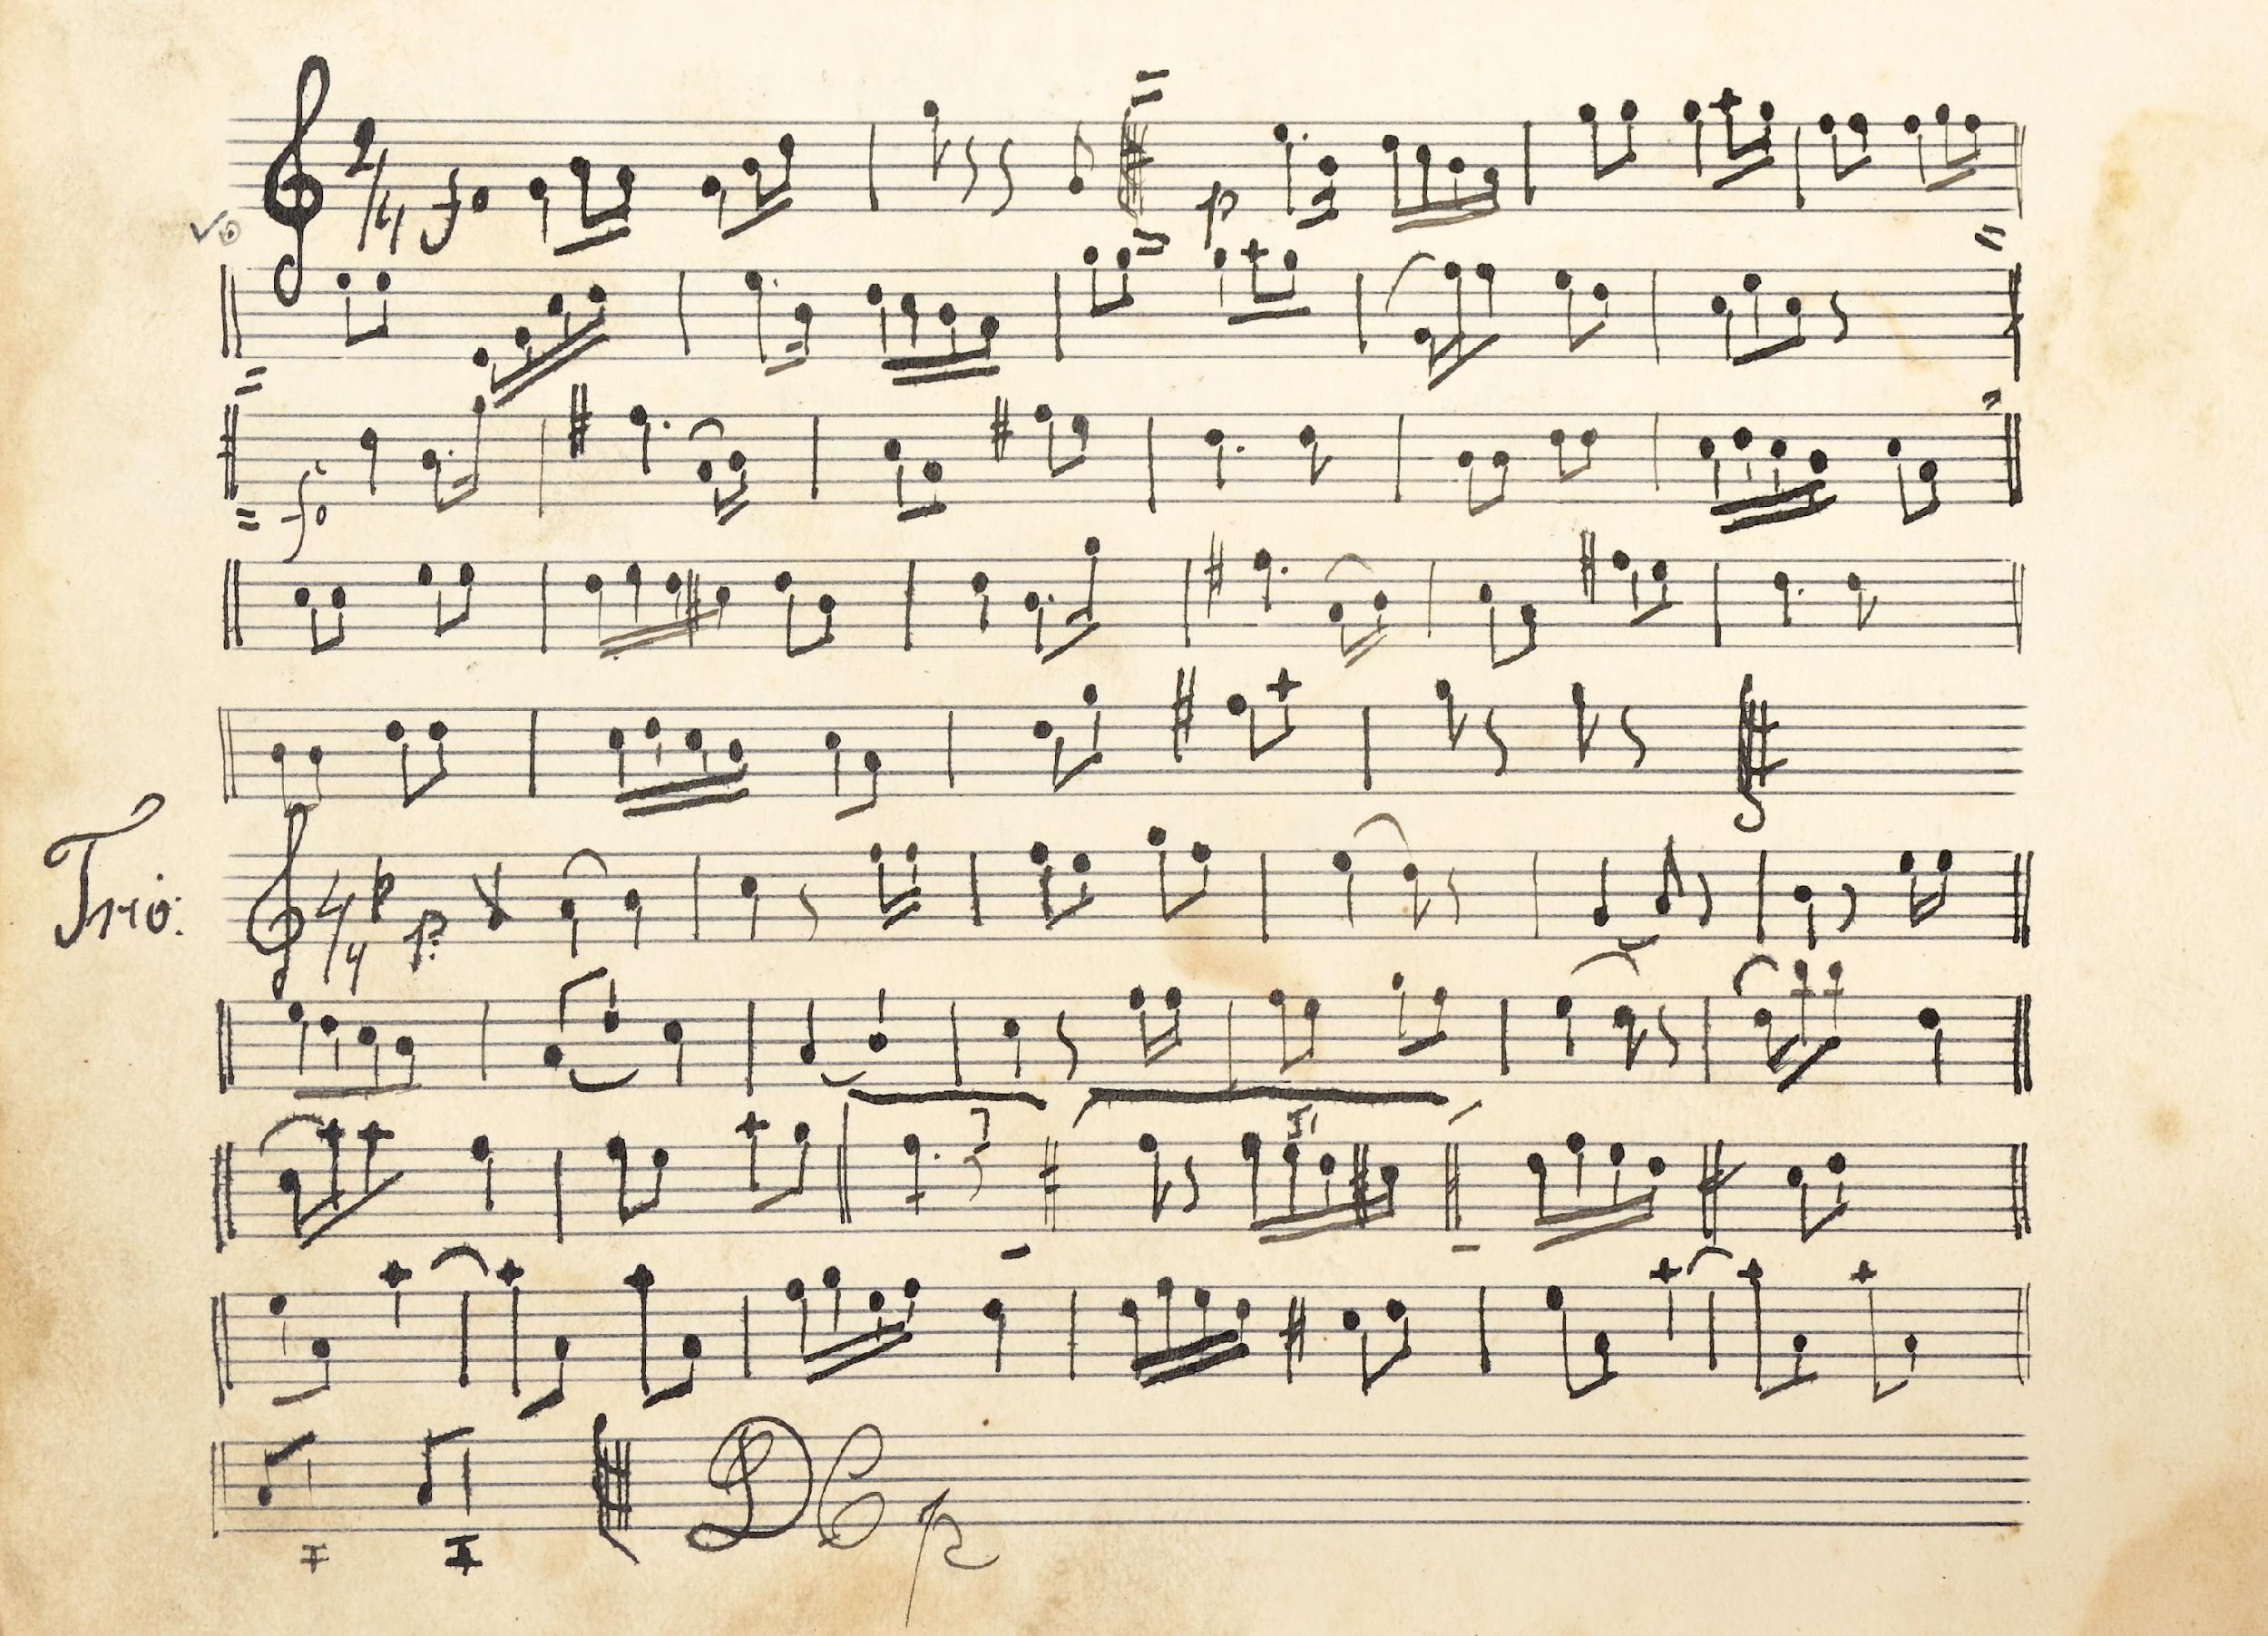
MUSIC NOTATION
At first, music notation can feel overwhelming. After all, it is a different language! However, there’s no need to be afraid. Part of the rehearsal process includes dedicated music rehearsals, which are an enjoyable way to learn this language and practice your parts. The music director will support you to ensure you feel comfortable and confident when the show opens.

Slide 5
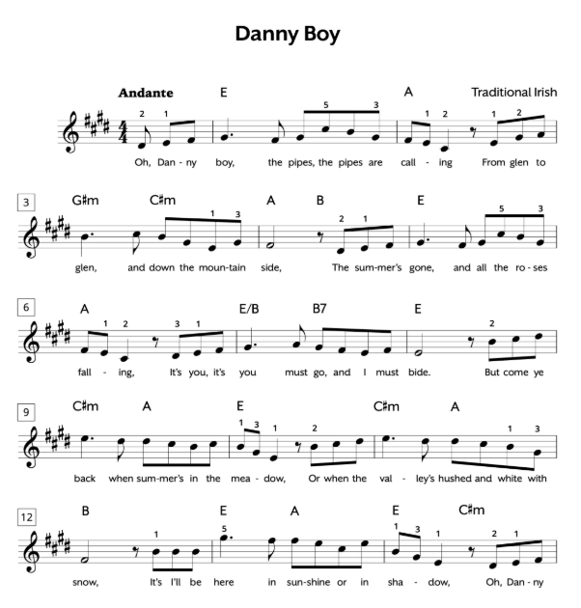
MUSIC NOTES
We call the five lines the “staff.” The higher the notes go on the staff, the higher it is to sing! The lower the note, the lower it is to sing.
They have different lengths based on what they look like, and you’ll probably begin to figure out which notes are longer the more and more we rehearse. Fortunately, you don’t have to be able to read music notes. Many singers can’t and still learn music very well!

Slide 6
WHEN SINGING IN REHEARSAL, YOU HAVE TWO OPTIONS
Follow along with the lyrics
Follow along with the music notation
Oh, Danny Boy, the pipes, the pipes are calling
From glen to glen, and down the mountain side.
The summer's gone, and all the roses falling,
It's you, it's you must go, and I must abide.
During rehearsal, I’ll give you page numbers so you can follow along! Use whichever you prefer and ask questions when needed.

Slide 7
What else should I know about music rehearsal?
We very likely won’t go from beginning to end - instead, we’ll bounce around from song to song throughout the show. Pay attention to what song title/page number we’re doing - I’ll be sure to say it before we start! If we’re not singing in order, there’s probably a good reason for it. If I forget to tell you, or you’re interested to know, just ask!
Music rehearsals can involve a lot of sitting and a lot of stopping and starting. There are a lot of you and you’re not always singing the same parts! Sometimes I’ll need to focus on a single person’s or small group’s part that doesn’t include you. It’s important to be patient, and don’t be afraid to ask for a break if you need one.
By the end of the rehearsal, you should be more comfortable with the songs we learned, but they probably won’t be perfect! I recommend you practice them at home, and if you have questions while you’re practicing, write them down or send me an email.

Slide 8
What is the best way to prepare for a music rehearsal?
I will let you know in advance what new songs we’ll be working on before each music rehearsal. To feel prepared, here are some things you can do ahead of time:
Listen to the song ahead of time- use the resources we have provided you or do a quick YouTube search.
Read through the lyrics or music notation in your script. Is it obvious where you sing? (i.e. your character’s name is clearly labeled?) If so, mark it! If not, I will let you know where you sing during the rehearsal.
Bring a pencil! You’ll need to make notes about when you sing, how loud to sing, and any other special instructions.

